Slide 1
RMA-T99X171.00
U602-eMMC Failure FA Report
Prepared by: PE- Luc
Date : 2024.06.03
"Listens to customers, Meet customer expectation"

Slide 2
#1. Problem Description
Issue Description
When | 2024/April
Who | ALT customer
Where | SK networks warehouse, Anseong, Korea.
What | ALT customer feedback that they found out 76/1728pcs pcs RMA has boot up fail.
Why | This issue follow eMMC U602 (P/N: 067.00140.005, Vendor: SAMSUNG) material fail.
How | Product boot up fail and can't download Factory FW stop 7%
How many | 64/1728pcs RMA( F/R: 3.70%) as table below.
Notes:
MA5800-X7#display cable modem <MAC> detail

Slide 3
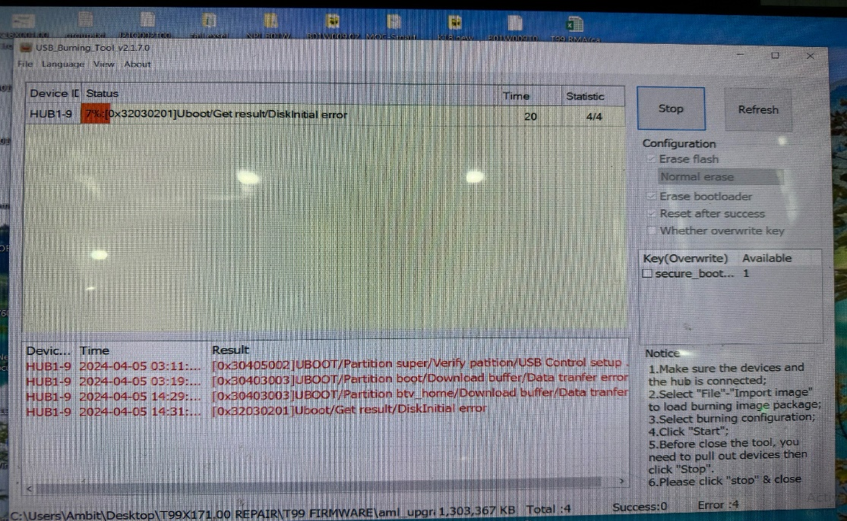
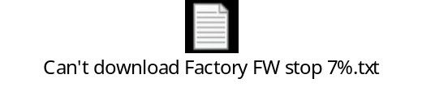

#2. Background Information
T99X171.00 with fail: Product boot up fail
Defect rate: 76/1728pcs = 37037 DPPM
Download Factory FW
Console UK FAIL 7%
Console UK PASS
Can't download Factory FW stop 7%
Console UK
Summary:
- Summary: The NG board boot up fail when download Factory Firmware stop 7%
Notes:
5.26891E-07 4.96855E-07

Slide 4
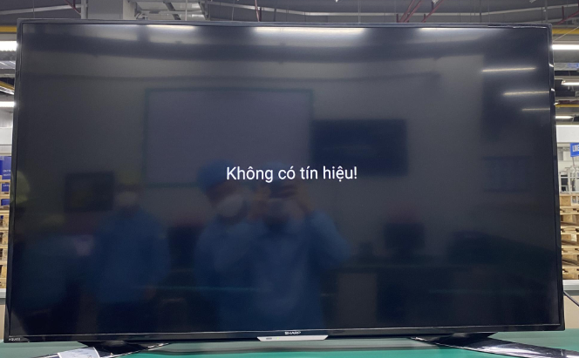
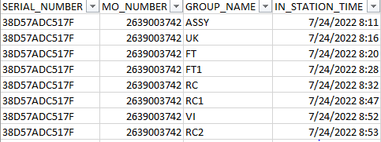
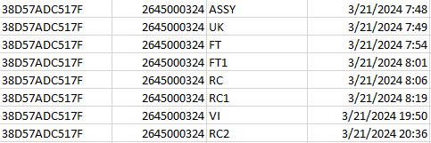
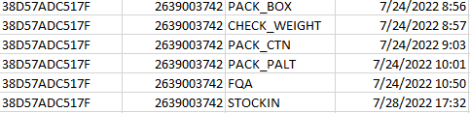

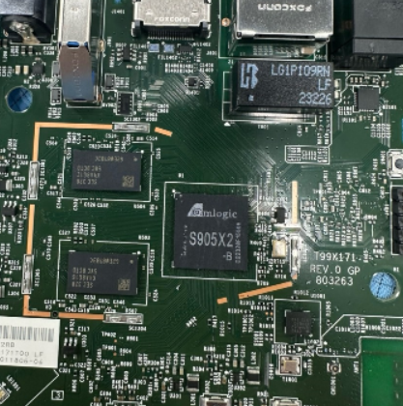
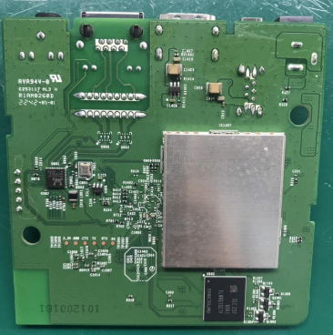
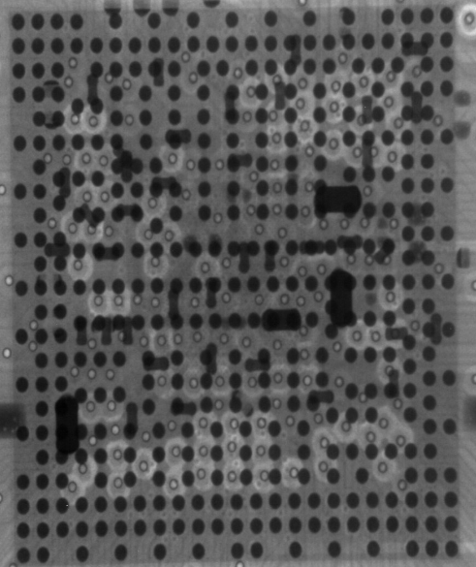
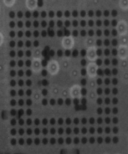
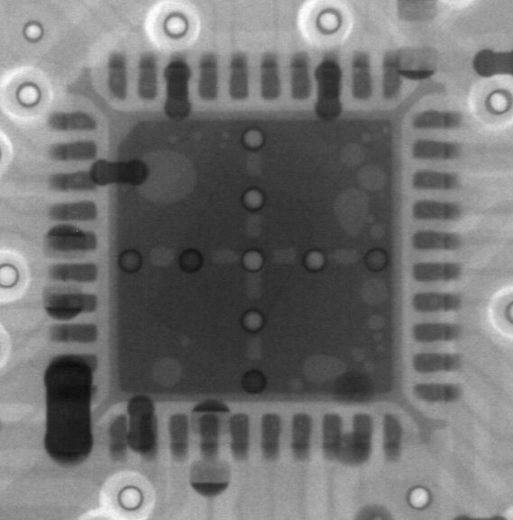
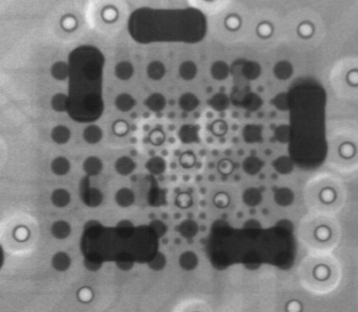
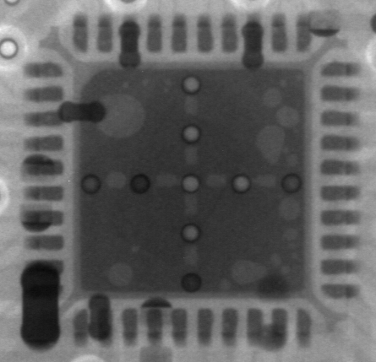
#3. System level
Board level
No# | Item check | Image reference | Result | Remark
1 | Recheck Boot up at OBA station |  | Fail | NG units boot up fail
2 | Recheck production data |  | Normal | Both Dot level & T level are OK
3 | Visual inspection |  | Normal | No process effecting to failure
4 | X-Ray focus on SoC, U801, U1101, U1001, eMMC location |  | Normal
Boot Up Fail
SoC
eMMC
U1101
U1001
U801
Summary: - Recheck Boot up 2/2pcs NG → Boot up fail
- Recheck production data, VI, X-ray are OK
"Listens to customers, Meet customer expectation"

Slide 5
#4. Failure Analysis NG1 + NG2 + NG3 Units
Component level -1
Measure impedance and VF NG1 + NG2 +NG3 units, received result as table below:
Measure impedance & VF voltage NG1 + NG2 Units
Location | Description | NG1 sample |  | NG2 sample |  | NG3 sample |  | OK sample
 |  | Impedance | VF | Impedance | VF | Impedance | VF | Impedance | VF
R328 | PP_PWR_IN | 3.33K | 0.503 | 3.313K | 0.506 | 3.046k | 0.5 | 3.260K | 0.504
L303 | P1V2 | 169.5 | 0.084 | 169.9 | 0.084 | 191.1 | 0.092 | 182 | 0.089
R325 | P2V5 | 21.37K | 0.390 | 21.69K | 0.393 | 18.45K | 0.363 | 21.61K | 0.392
L304 | P3V3 | 2.723k | 0.33 | 2.741K | 0.346 | 19.59K | 0.348 | 19.59K | 0.348
C322 | eMMC_VDDQ | 22.53k | 0.432 | 23.25K | 0.41 | 23.14K | 0.416 | 23.14K | 0.416
L301 | VDDCPU | 61.9 | 0.071 | 56.3 | 0.061 | 88.7 | 0.085 | 66.1 | 0.075
L302 | VDD_EE | 16.3 | 0.015 | 21.2 | 0.020 | 25.2 | 0.023 | 35.5 | 0.037
L801 | ETH_DVDD10 | 1.823k | 0.311 | 1.821K | 0.294 | 1.952K | 0.287 | 1.952K | 0.299
Summary:
- Measure impedance and VF NG1 + NG2 +NG3 units → No found out abnormal
"Listens to customers, Meet customer expectation"

Slide 6
II. Failure Analysis NG1 + NG2 +NG3 Units
Component level -2
Measure impedance: Remove U1 and measure impedance result as table below:
NO# | Pin# | Description | NG 1 | NG 2 | NG 3 | OK Sample
 |  |  | Impedance | Impedance | Impedance | Impedance
1 | J32 | AVDD18_PCIe | 196.3M | 230K | 228K | 225K
2 | L29 | AVDD33_USB | 0.922M | 0.912M | 0.942M | 0.931M
3 | L31 | VDDIO_H | 30 | 32 | 27 | 38
4 | L33 | AVDD18_ENET | 1.495M | 1.62M | 1.495M | 1.525M
5 | L35 | AVDD18_USB | 1.321M | 1.345K | 1.345M | 1. 353M
6 | G14 | VDDQ | 1.7M | 1.94M | 58.7K | 32.3K
7 | G29 | VDDIO_AO | 40.1K | 42.2K | 40.6K | 37.3K
8 | N31 | AVDD18_AUDIO | 0.967M | 1.075M | 0.853M | 0.908M
9 | N33 | AVDD18_HDMI | 1.592M | 1.471M | 1.466M | 1.426M
10 | P13 | VDDQ | 11.25K | 11.12K | 10.82K | 10.11K
11 | P15 | VDDQ | 11.25K | 11.12K | 10.82K | 10.10K
12 | J14 | VDDQ | 11.28K | 11.85K | 9.88K | 10.26K
13 | J29 | VDDIO_C | 41.1 | 40.3 | 41.3 | 40.4
14 | R26 | AVDD0V8_USB_PCIe | 4.232K | 3.941K | 4.301K | 3.972K
15 | R28 | AVDD0V8_HDM | 28.56K | 28.87K | 29.54K | 28.84K
16 | R31 | AVDD18_AO | 1.252M | 1.17M | 1.076M | 1.14M
17 | R33 | AVDD18_CVBS | 1.413M | 1.42M | 1.323M | 1.379M
18 | AA23 | AVDD18_AO | 0.781M | 1.158M | 1.065M | 1.167M
19 | AG20 | VDDCPU | 44.4 | 42.8 | 50.2 | 48.5
20 | AG26 | VDD_EE | 11 | 29 | 29.9 | 27.2
21 | U15 | VDDQ | 58.5K | 56k | 74.2K | 69K
22 | U17 | VDD_EE | 11.1 | 28 | 29.6 | 25
23 | AC15 | AVDD_DDRPLL | 0.785M | 0.703M | 0.696M | 0.656M
24 | AJ15 | VDDQ | 11.72K | 11.09K | 10.76K | 10.49K
NO# | Pin# | Description | NG 1 | NG2 | NG3 | OK Sample
 |  |  | Impedance | Impedance | Impedance | Impedance
25 | U26 | VDD_EE | 34.2 | 34.7 | 34.9 | 31.5
39 | AJ20 | VDDCPU | 45.3 | 47.8 | 49.4 | 43.5
27 | AJ23 | VDDCPU | 45.3 | 47.6 | 49.5 | 43.5
28 | AJ26 | VDD_EE | 27.8 | 27.1 | 28.3 | 25.7
29 | AJ29 | VDD_EE | 28.8 | 28.4 | 28.9 | 26.2
30 | AJ31 | VDDAO_0V8 | 0.823M | 1.17K | 1.366K | 0.953K
31 | AJ39 | AVDD18_AO | 0.988M | 1.11M | 1.013M | 1.082M
32 | AE26 | VDD_EE | 10.9 | 29 | 29.2 | 26.7
33 | AL20 | VDDCPU | 45.1 | 47.9 | 50.3 | 44.7
34 | AL23 | VDDCPU | 45 | 48 | 50.2 | 44.8
35 | Y15 | VDDQ | 54.8K | 72.1K | 55.5K | 70.4K
36 | AF15 | VDDQ | 54.2K | 70.6K | 54.4K | 69.4K
37 | AF17 | VDD_EE | 27.7 | 27.7 | 28.4 | 25.9
38 | AF29 | VDD_EE | 10.9 | 27.7 | 28.4 | 25.8
39 | AF31 | VDD_EE | 10.7 | 27.5 | 28.3 | 25.8
40 | AM31 | VDD_EE | 26.8 | 13.3 | 37.8 | 40.7
41 | AU26 | VDDCPU | 48.6 | 49.4 | 50.3 | 44.7
42 | AV37 | VDDIO_X | 2.63M | 2.51M | 2.668M | 2.54M
43 | AV39 | VDDIO_Z | 3.41M | 3.45M | 3.520M | 3.47M
44 | AN23 | VDDCPU | 2.8M | 3.17M | 3.09M | 3.16M
45 | AW20 | VDDIO_BOOT | 3.540M | 3.18M | 3.108M | 3.03M
46 | AW26 | VDDCPU | 54.8 | 61 | 64.8 | 58.2
47 | AR26 | VDDCPU | 55.8 | 60.8 | 64.9 | 53.4
Summary: After measure impedance U1 no found out abnormal.
,
"Listens to customers, Meet customer expectation"

Slide 7
#6. Failure Analysis NG1 + NG2 Units
Component level -3
Measure impedance: Remove U602 and measure impedance result as table below:
Pin# | Description | NG 1 | NG 2 | NG 3 | OK Sample
 |  | Impedance | Impedance | Impedance | Impedance
A3 | DAT0 | NA | NA | NA | NA
A4 | DAT1 | NA | NA | NA | NA
A5 | DAT2 | NA | NA | NA | NA
B2 | DAT3 | 1.635M | 1.607M | 1.522M | 1.433M
B3 | DAT4 | 18.74K | 17.80K | 16.31K | 25.78K
B4 | DAT5 | NA | NA | NA | NA
B5 | DAT6 | NA | NA | NA | NA
B6 | DAT7 | NA | NA | NA | NA
K5 | RSTN | 1.637M | 1.606M | 1.512M | 1.516M
C6 | VDD | NA | NA | NA | NA
M4 | VDD | NA | NA | NA | NA
N4 | VDD | NA | NA | NA | NA
P3 | VDD | NA | NA | NA | NA
P5 | VDD | NA | NA | NA | NA
E6 | VDDF | 2.339M | 2.326M | 2.327M | 2.266M
F5 | VDDF | 2.340M | 2.326M | 2.328M | 2.262M
J10 | VDDF | 2.335M | 2.224M | 2.294M | 2.261M
K9 | VDDF | 2.323M | 2.328M | 2.328M | 2.299M
C2 | VDDI | 1.615M | 1.608M | 1.521M | 1.460M
M5 | CMD | NA | NA | NA | NA
Pin# | Description | NG 1 | NG2 | NG3 | OK Sample
 |  | Impedance | Impedance | Impedance | Impedance
H5 | Data Strobe | NA | NA | NA | NA
M6 | CLK | NA | NA | NA | NA
J5 | VSS | NA | NA | NA | NA
A6 | VSS | NA | NA | NA | NA
C4 | VSS | NA | NA | NA | NA
E7 | VSS | 0.3 | 0.2 | 0.2 | 0.2
G5 | VSS | 0.2 | 0.42 | 0.3 | 0.2
H10 | VSS | 0.2 | 0.3 | 0.3 | 0.3
K8 | VSS | NA | NA | NA | NA
N2 | VSS | NA | NA | NA | NA
N5 | VSS | NA | NA | NA | NA
P4 | VSS | NA | NA | NA | NA
P6 | VSS | NA | NA | NA | NA
Summary: After measure impedance U602 no found out abnormal.
"Listens to customers, Meet customer expectation"

Slide 8
#5. Failure Analysis NG1 + NG2 + NG3 Units
Component level -4
Swap verification between OK and NG U602 material and retest all functions + OBA test, result as table below:
Swap verification | NG1 | NG2 | NG3
OK board + OK U602 | OK | OK | OK
NG board + NG U602 | NG | NG | NG
OK board + NG U602 | NG | NG | NG
NG board + OK U602 | OK | OK | OK
Summary: As analysis above this issue follow U602 (P/N: 002.02152.005) component.
"Listens to customers, Meet customer expectation"

Slide 9
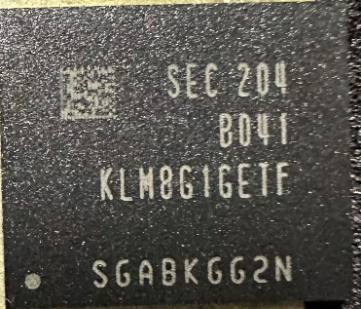
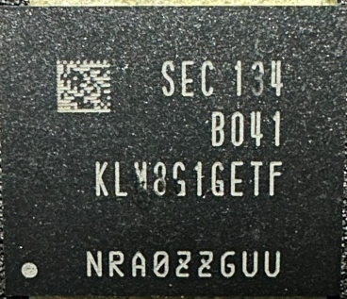
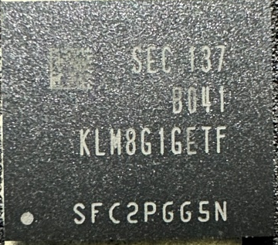
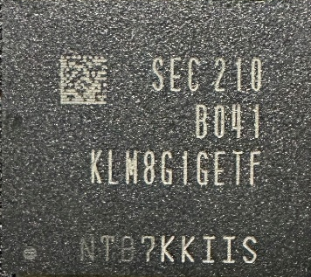

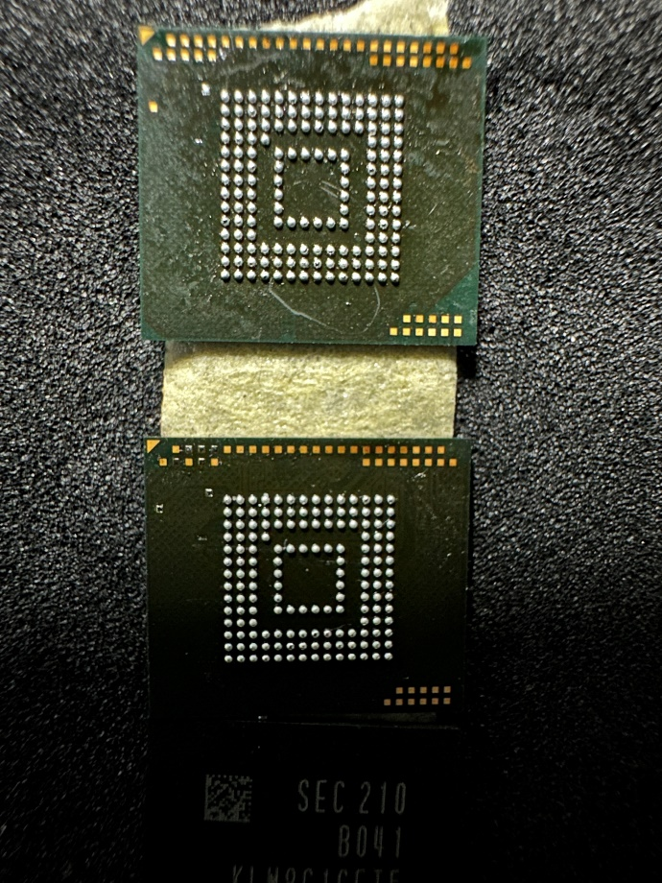
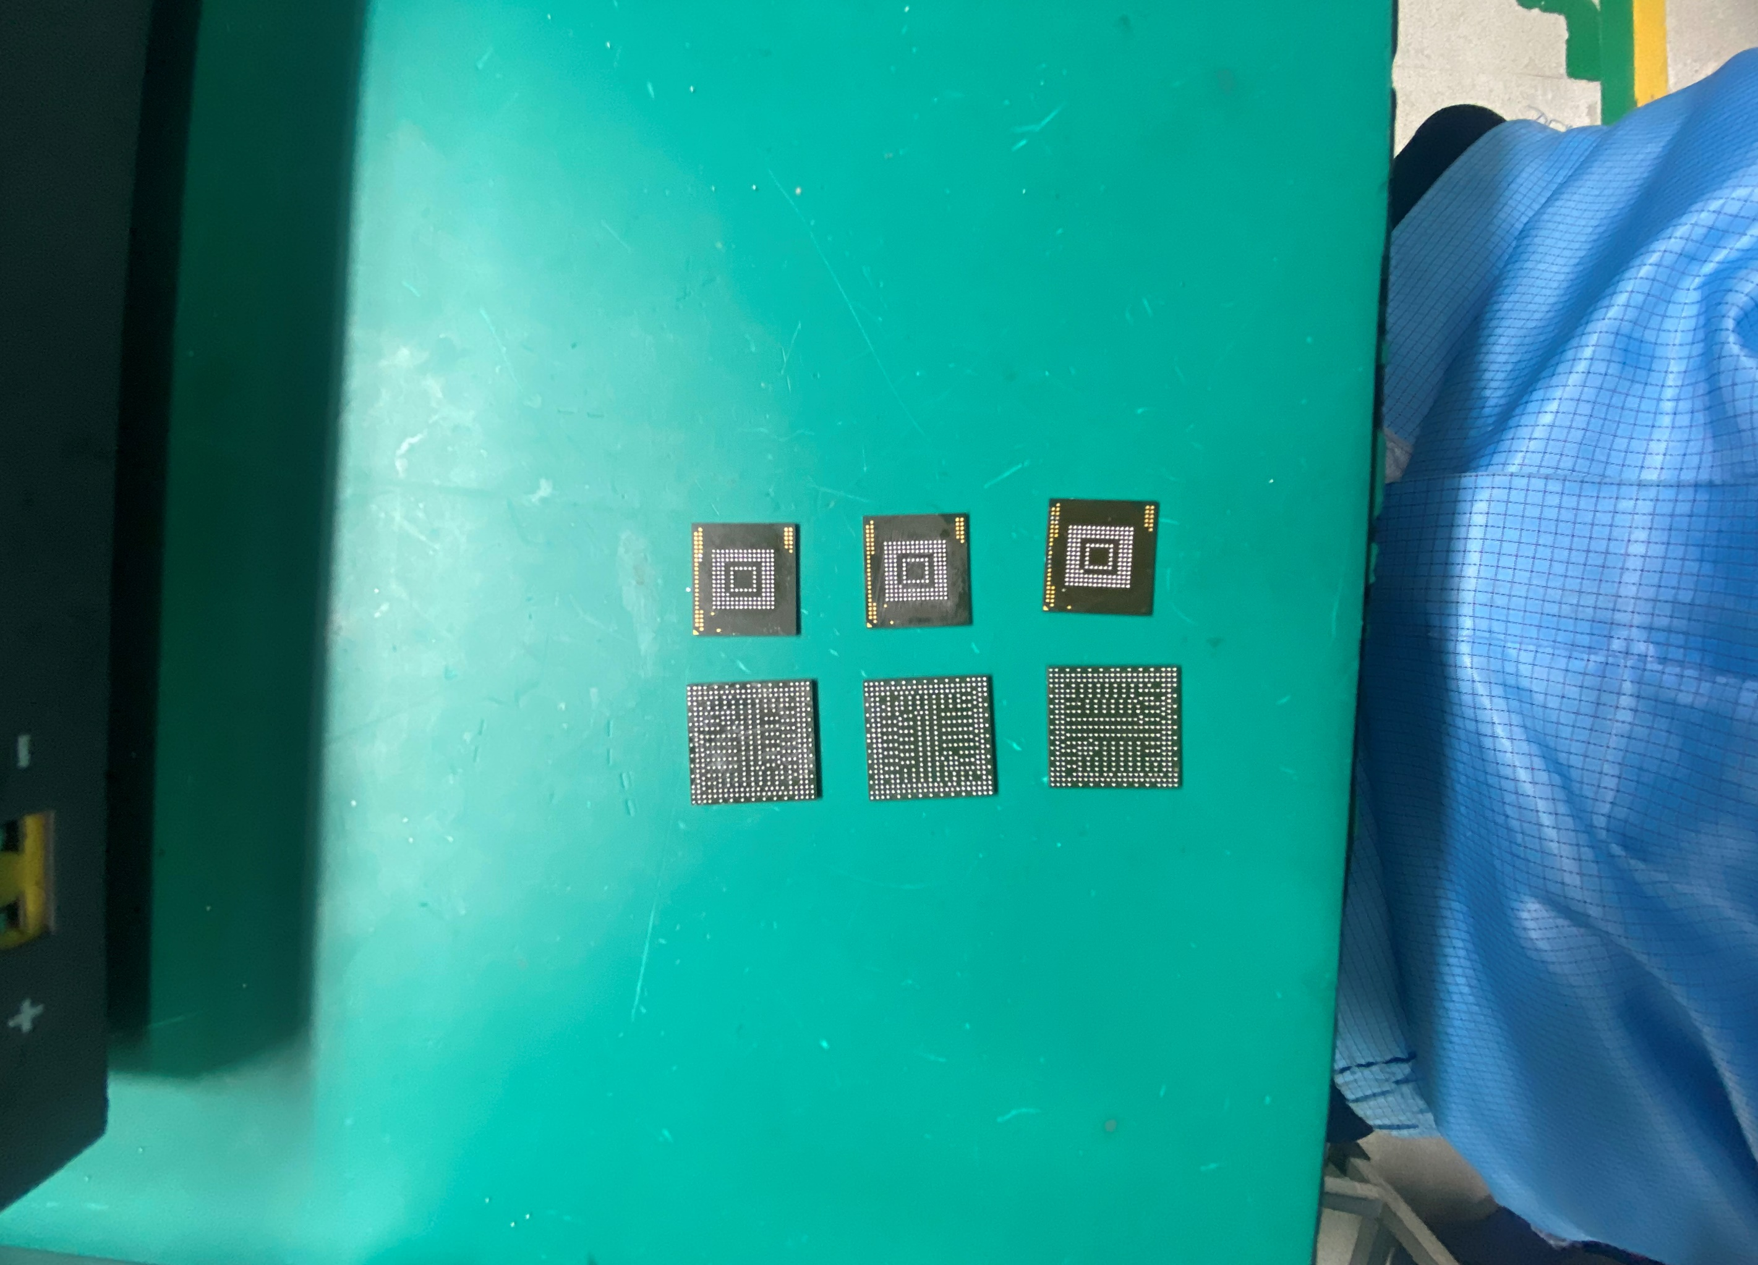

#7. IC U602 Information Shipping
Visual Inspection and sent 5pcs NG sample to SQE pictures as below:
NG.# | NG1 | NG2 | NG3 | NG4 | NG5
Date Code | SEC204 | SEC134 | SEC137 | SEC210 | SEC243
Top side
Bottom side
Summary:
- Summary: VI 5pcs NG sample will sent to SQE Don’t find out any abnormal..

Slide 10
#8. Conclusion
Root cause:
Occur cause: Follow <U602> material (P/N: 067.00140.005, Vendor: SAMSUNG)
Escape cause: FATP can’t cover this issue
Action:
Send FA report and NG material to vendor SAMSUNG for future analyzing. Owner: SQE Naomi .Due date: 04/20
RD co-work with SAMSUNG taking action for this issue. Owner: RD Cooper. Due date: ASAP
"Listens to customers, Meet customer expectation"

Slide 11

#9. Vendor’s Conclusion
On 29/05 SamSung vendor feedback for this issue.
- Based on the test customer’s results, we think the failed units were caused by unexpected environment which is sudden power off, unstable power supply etc.
This is attached: →
Action:
Continue co-work with SAMSUNG vendor taking action and more detailed reason for this issue. Owner: PE_Luc. Due date: 05/06
Customers should update and maintain equipment: Ensure equipment is updated with software and perform routine maintenance to minimize errors due to software problems mechanical damage.
Identify and repair infrastructure issues: Inspect and repair infrastructure-related issues such as electrical wiring, outlets, electrical panels. Etc.cc to ensure that they meet safety and operational standards.

